Slide 1
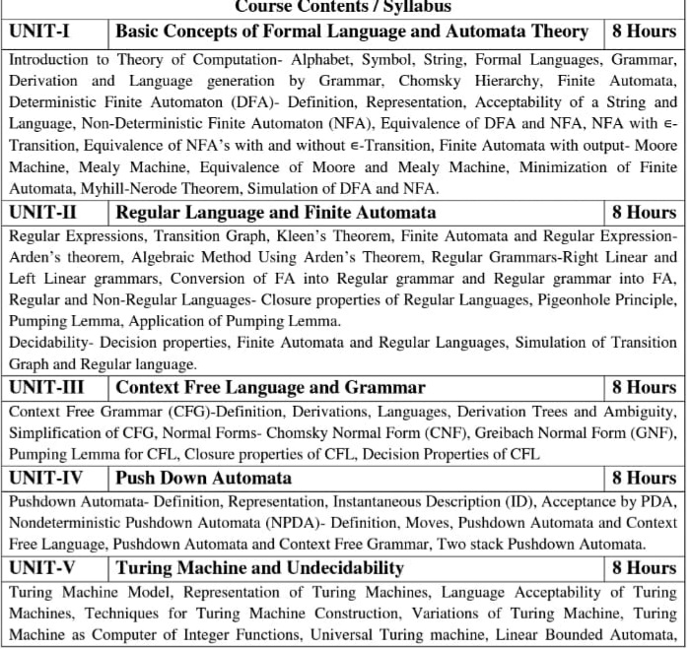
Syllabus

Slide 2
Branch wise Applications
Computer Science/ IT
Automaton is nothing but a machine which accepts the strings of a language L over an input alphabet Σ. There are four different types of Automata that are mostly used in the theory of computation (TOC).
Finite-state machine (FSM).
Pushdown automata (PDA).
Linear-bounded automata (LBA).
Turing machine (TM).

Slide 3
Course Objectives
The primary objective of this course is to introduce students to the foundations of computability theory. The other objectives include:
Introduce concepts in automata theory and theory of computation
Identify different formal language classes and their relationships
Design grammars and recognizers for different formal languages
Prove or disprove theorems in automata theory using its properties
Determine the decidability and intractability of computational problems

Slide 4
Course Outcomes
CO | At the end of course , the student will be able to | Bloom’s (KL)
CO1 | Analyze, design finite automata, pushdown automata, Turing machines, formal languages, and grammars | K₄, K₅
CO2 | Analyze and design, Turing machines, formal languages, and grammars | K₄, K₅
CO3 | Demonstrate the understanding of key notions, such as algorithm, computability, decidability, and complexity through problem solving | K₁, K₅
CO4 | Prove the basic results of the Theory of Computation | K₂, K₃
CO5 | State and explain the relevance of the Church-Turing thesis | K₁, K₅

Slide 5
Program Outcomes (POs)
Engineering Graduates will be able to:
1. Engineering knowledge: Apply the knowledge of mathematics, science, engineering fundamentals, and an engineering specialization to the solution of complex engineering problems.
2. Problem analysis: Identify, formulate, review research literature, and analyze complex engineering problems reaching substantiated conclusions using first principles of mathematics, natural sciences, and engineering sciences.
3. Design/development of solutions: Design solutions for complex engineering problems and design system components or processes that meet the specified needs with appropriate consideration for the public health and safety, and the cultural, societal, and environmental considerations.
4. Conduct investigations of complex problems: Use research-based knowledge and research methods including design of experiments, analysis and interpretation of data, and synthesis of the information to provide valid conclusions.

Slide 6
Program Outcomes (POs)
Contd..
5. Modern tool usage: Create, select, and apply appropriate techniques, resources, and modern engineering and IT tools including prediction and modeling to complex engineering activities with an understanding of the limitations.
6. The engineer and society: Apply reasoning informed by the contextual knowledge to assess societal, health, safety, legal and cultural issues and the consequent responsibilities relevant to the professional engineering practice.
7. Environment and sustainability: Understand the impact of the professional engineering solutions in societal and environmental contexts, and demonstrate the knowledge of, and need for sustainable development.
8. Ethics: Apply ethical principles and commit to professional ethics and responsibilities and norms of the engineering practice.

Slide 7
Program Outcomes (POs)
Contd..
9. Individual and team work: Function effectively as an individual, and as a member or leader in diverse teams, and in multidisciplinary settings.
10. Communication: Communicate effectively on complex engineering activities with the engineering community and with society at large, such as, being able to comprehend and write effective reports and design documentation, make effective presentations, and give and receive clear instructions.
11. Project management and finance: Demonstrate knowledge and understanding of the engineering and management principles and apply these to one’s own work, as a member and leader in a team, to manage projects and in multidisciplinary environments.
12. Life-long learning: Recognize the need for, and have the preparation and ability to engage in independent and life-long learning in the broadest context of technological change.

Slide 8
CO-PO correlation matrix
 | PO1 | PO2 | PO3 | PO4 | PO5 | PO6 | PO7 | PO8 | PO9 | PO10 | PO11 | PO12
CO1 | 2 | 2 | 3 | 3 | 2 | 2 | - | - | 2 | 1 | - | 3
CO2 | 1 | 3 | 2 | 3 | 2 | 2 | - | 1 | 1 | 1 | 2 | 2
CO3 | 2 | 2 | 3 | 2 | 2 | 2 | - | 2 | 2 | 1 | 2 | 3
CO4 | 2 | 2 | 2 | 3 | 2 | 2 | - | 2 | 2 | 1 | 1 | 3
CO5 | 3 | 2 | 2 | 2 | 2 | 2 | - | 2 | 1 | 1 | 1 | 2
Average | 2 | 2.2 | 2.4 | 2.6 | 2 | 2 | - | 1.4 | 1.6 | 1 | 1.2 | 2.6

Slide 9
Program Specific Outcomes
On successful completion of graduation degree the Computer Science &
Engineering graduates will be able to:
PSO1: | Design and develop the Hardware and Software systems.
PSO2: | Understand the interdisciplinary computing techniques and an ability to apply them in the design of advanced computing.
PSO3: | Understand the programming methodology, software development paradigms, design and analysis of Algorithms, Operating Systems, Digital Logic Design, Theory of Computation, Discrete Mathematics, Compiler Design, etc.
PSO4: | To integrate & manage the various phases/components of software development projects of society.

Slide 10
CO-PSO correlation matrix
CO | PSO
 | PSO1 | PSO2 | PSO3 | PSO4
CO1 | 2 | 2 | 2 | 2
CO2 | 2 | 2 | 1 | 1
CO3 | 2 | 2 | 1 | 1
CO4 | 2 | 2 | 1 | 1
CO5 | 2 | 2 | 2 | 2
Average | 2 | 2 | 1.4 | 1.4

Slide 11
Program Educational Objectives
PEO1: To have an excellent scientific and engineering breadth so as to
comprehend, analyze, design and provide sustainable solutions for
real-life problems using state-of-the-art technologies.
PEO2:To have a successful career in industries, to pursue higher studies or
to support entrepreneurial endeavors and to face global challenges.
PEO3:To have an effective communication skills, professional attitude,
ethical values and a desire to learn specific knowledge in emerging
trends, technologies for research, innovation and product
development and contribution to society.
PEO4: To have life-long learning for up-skilling and re-skilling for
successful professional career as engineer, scientist, entrepreneur
and bureaucrat for betterment of society

Slide 12

Result Analysis
Not Applicable.
15

Slide 13
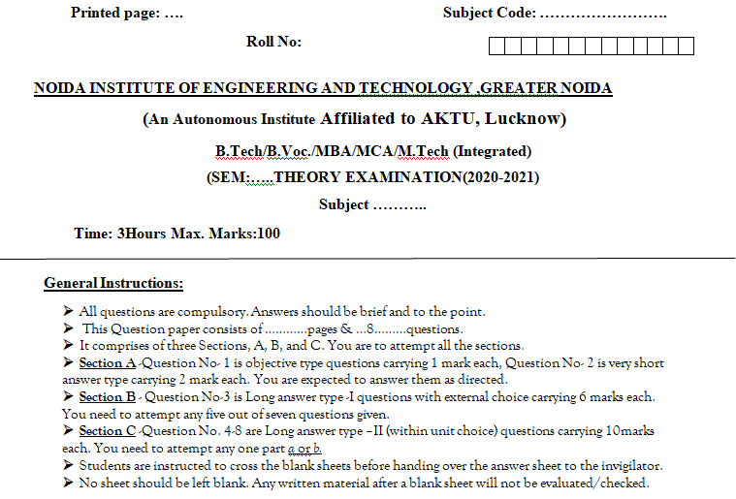
End Semester Question Paper Template

Slide 14
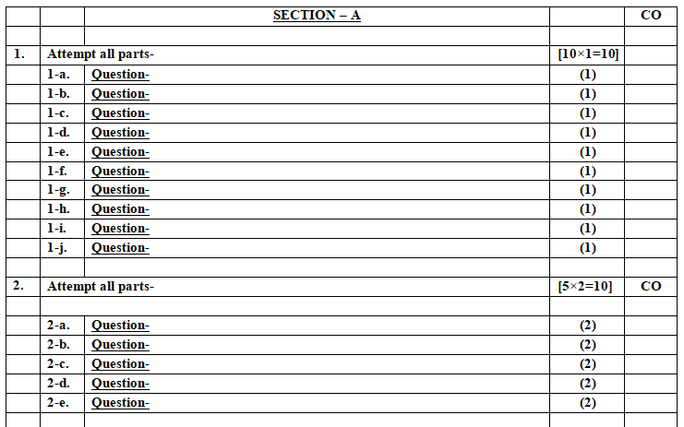
End Semester Question Paper Template

Slide 15
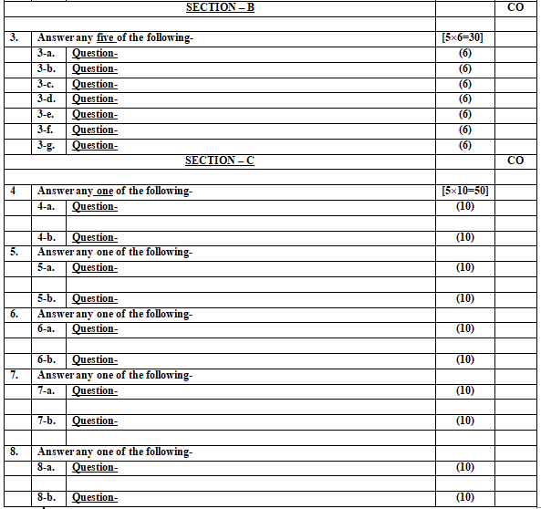
End Semester Question Paper Template

Slide 16

Brief Introduction about the Subject with videos
Introduction: Automata theory is the study of abstract machines and automata, as well as the computational problems that can be solved using them. It is a theory in theoretical computer science.
Introduction, Finite Automata, Regular Expressions | Video Lectures | Theory of Computation | Mathematics | MIT OpenCourseWare
Unit I
https://nptel.ac.in/courses/106/104/106104028/Lecture 1 -10, Lecture 16, 17 18, 19
https://nptel.ac.in/courses/113/11111/1003016/ https://www.youtube.com/results?search_query=%23AutomataTheory
Unit II
https://nptel.ac.in/courses/106/104/106104028/Lecture 11 -15
https://nptel.ac.in/courses/113/11111/1003016/ https://www.youtube.com/results?search_query=%23AutomataTheory
Unit III
https://nptel.ac.in/courses/106/104/106104028/Lecture 20 -30
https://nptel.ac.in/courses/106/106/106106049/ https://www.youtube.com/results?search_query=%23AutomataTheory
Unit IV
https://nptel.ac.in/courses/106/104/106104028/Lecture 31 -33
https://nptel.ac.in/courses/113/11111/1003016/ https://www.youtube.com/results?search_query=%23AutomataTheory
Unit V
https://nptel.ac.in/courses/106/104/106104028/Lecture 34-42
https://nptel.ac.in/courses/113/11111/1003016/ https://www.youtube.com/results?search_query=%23AutomataTheory

Slide 17
Prerequisite for the Course
Basics operations of mathematics.
Discrete mathematics.
Predicate logic.

Slide 18
Recap
Finite automata is an abstract computing device. It is a mathematical model of a system with discrete inputs, outputs, states and a set of transitions from state to state that occurs on input symbols from the alphabet Σ.

Slide 19
Unit Contents
Topics | Duration (in Hours)
Introduction to theory of computation | 1
Finite Automata | 5
Minimization of DFA | 1
Finite Automata with Output | 2
Topics | Duration (in Hours)
Assignment, Tutorials and Quiz | 1

Slide 20
Unit Objectives
Objective of the unit is to make students able to:
Construct DFA and NFA.
Apply the uses of FA in computational problems.
Minimize the Finite automata.
Simulate NFA and DFA.

Slide 21
CO-PO correlation matrix
 | PO1 | PO2 | PO3 | PO4 | PO5 | PO6 | PO7 | PO8 | PO9 | PO10 | PO11 | PO12
CO1 | 2 | 2 | 3 | 3 | 2 | 2 | - | - | 2 | 1 | - | 3

Slide 22
CO-PSO correlation matrix
CO | PSO
 | PSO1 | PSO2 | PSO3 | PSO4
CO1 | 2 | 2 | 2 | 2

Slide 23
Finite Automata
Objective of the Topic
The objective of the topic is to make the student able to:
Understand the requirement of finite automata.
Implement Finite automata
Realize the expressive power of Ɛ- NFA, NFA and DFA
Minimize the FA

Slide 24
Finite Automata
Topic mapping with Course Outcome
Topic | CO1 | CO2 | CO3 | CO4 | CO5
Finite Automata | 3 | - | - | - | -

Slide 25
Introduction to Automata
Automaton is the system that performs some function without human intervention.
The plural of Automaton is Automata.
Automata theory is the study of abstract computational machines and the computational problems that can be solved using these machines
Abstract machine are (simplified) mathematical models of real computations

Slide 26
Introduction to Automata
Temporary Memory
Automaton
CPU
Input
Output
Program Memory

Slide 27
Introduction to Automata
Compute f(x)=x²+3?
Temporary Memory
y= 5*5
f(x)=25+3
CPU
Input
X=5
Output
f(x)=28
Program Memory
y=x*x
f(x)=y+3

Slide 28
Why do we need abstract models?
Introduction to Automata
SWITCH
BATTERY
input: switch
output: light bulb
actions: flip switch
states: on, off

Slide 29
A simple “computer”
Introduction to Automata
SWITCH
f
BATTERY
start
on
off
f
input: switch
output: light bulb
actions: f for “flip switch”
states: on, off
bulb is on if and only if there was an odd number of flips

Slide 30
Another “computer”
Introduction to Automata
1
1
start
off
off
1
BATTERY
2
2
2
2
1
2
off
on
1
inputs: switches 1 and 2
actions: 1 for “flip switch 1”
actions: 2 for “flip switch 2”
states: on, off
bulb is on if and only if both switches were flipped an odd number of times

Slide 31
A Design Problem
Introduction to Automata
1
?
4
5
BATTERY
2
3
Can you design a circuit where the light is on if and only if all the switches were flipped exactly the same number of times?
Such devices are difficult to reason about, because they can be designed in an infinite number of ways

Slide 32
A Design Problem
Introduction to Automata
By representing them as abstract computational devices, or automata, we will learn how to answer such questions
  What can a given type of device compute, and what are its limitations?
  Is one type of device more powerful than another?

Slide 33

Basic Concept
Introduction to Automata
  Every automaton consists of some essential features as in real computers.
    It has a mechanism for reading input. i.e. Input Tape
    The automaton can produce output of some form.
      If the output is Binary (accept or reject) - Accepter.
      Output sequence in response to an input sequence- Transducer
    The automaton may have a temporary storage
    The most important feature of the automaton is its control unit.
Input Tape
Finite Control
Output
Temp Storage

Slide 34
Different Types of Automata
finite automata | Devices with a finite amount of memory. Used to recognizer or string matching.
push-down automata | Devices with infinite memory that can be accessed in a restricted way. Used to model parsers, etc.
Turing Machines | Devices with infinite memory. Used to model any computer.
Linear Bounded Automata (time-bounded Turing Machines) | Infinite memory, but bounded running time. Used to model any computer program that runs in a “reasonable” amount of time.

Slide 35
Common terms used in Automata
Alphabet
An alphabet is a finite, non-empty set of symbols.
It is represented by ∑.
Ex:
∑={0,1} is binary alphabet.
∑={0,1,2,3,4,5,6,7,8,9} is decimal alphabet.
∑={a,b,c,…..,z} is lower-case alphabet.

Slide 36
Common terms used in Automata
Strings/Words
A string or word is a finite sequence of symbols over ∑.
Ex:
w = 10110 is a string over ∑={0,1}.

Slide 37
Common terms used in Automata
Length of a string
or
Power of ∑
∑^{k} is the set of strings of length k (|w|=k).
Ex:
If ∑={a,b} then
∑⁰= {Ɛ} , called Epsilon.
∑¹ = {a,b}
∑² = {aa,ab,ba,bb}

Slide 38
Common terms used in Automata
Reverse of a string
Reverse of a string, w is represented as w^{R}.
Ex:
If w=xyz then w^{R} =zyx.
Substrings of a string
If w=xyz then its substrings are:
Ɛ, x, y, z, xy, yz, zx, xyz

Slide 39
Common terms used in Automata
Prefix of a string
If w=xyz then its prefixes are:
Ɛ, x, xy, xyz
Suffix of a string
If w=xyz then its suffixes are:
Ɛ, z, yz, xyz

Slide 40
Common terms used in Automata
Languages
A set of strings, over ∑, is called a language.
Ex:
L₁=[w={0,1}*| w has equal number of 0’s and 1’s]
L₁={01,10,0011,0101,0110,1010,1001,1100,……}
L₂=[w={a,b}*| |w|≤3]
L₂={Ɛ,0,1,00,01,10,11,000,001,010,011,100,101,110,111}

Slide 41
Common terms used in Automata
Kleene closure
Kleene closure represented as ∑*, is set of strings of all possible length.
∑*=∑⁰ ∪∑¹ ∪∑² ∪∑³∪……….
Ex:
If ∑ ={a,b} then
∑*={Ɛ, a,b,aa,ab,ba,bb,aaa,aab,………..}

Slide 42
Common terms used in Automata
Positive closure
Positive closure represented as ∑⁺, is set of strings of all possible length.
∑⁺=∑¹ ∪∑² ∪∑³∪……….
Ex:
If ∑ ={a,b} then
∑⁺={a,b,aa,ab,ba,bb,aaa,aab,………..}
∑*= ∑⁰ ∪∑⁺

Slide 43
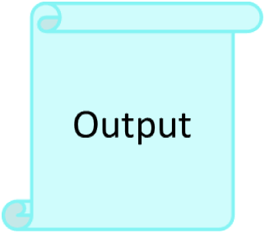
Finite Automata
Finite Automata: It is a mathematical model that works for several computer algorithms. It is called finite because it works on Finite set of Input symbols with Finite number of States and gives output in finite times.
Magnetic tape
Reading Head
Finite Control

Slide 44
Applications of Automata
Applications of Finite Automata
String Matching
Lexical Analysis
Design and Analysis of Digital Circuits

Slide 45
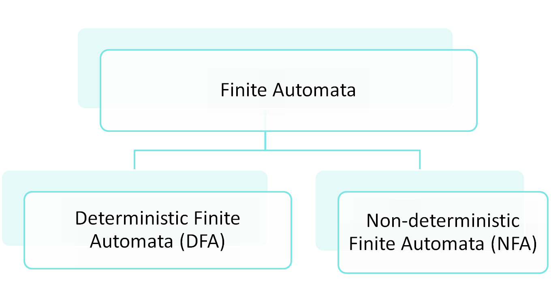
Finite Automata

Slide 46
DFA
For a DFA the machine moves to a particular unique state from a given state and given input that is why it is called Deterministic. As the number of states in DFA are Finite it is called Deterministic Finite Automata.
q1
a
q0
b
q2

Slide 47
Deterministic Finite Automata
A deterministic finite automaton (DFA) is a 5-tuple (Q, Σ, δ, q₀, F) where
  Q is a finite set of states
  Σ is finite set of alphabet
  δ: Q × Σ → Q is a transition function
  q₀ ∈ Q is the initial state
  F ⊆ Q is a set of accepting states (or final states).
In diagrams, the accepting states will be denoted by double loops

Slide 48
DFA
Representation of δ
  Transition Diagram
  Transition Table
  Transition Function

Slide 49
DFA
  Transition Diagram
M={ {q0, q1, q2}, {0,1}, δ, q0, q2}
0
0
1
0
q0
q1
q2
1
1

Slide 50
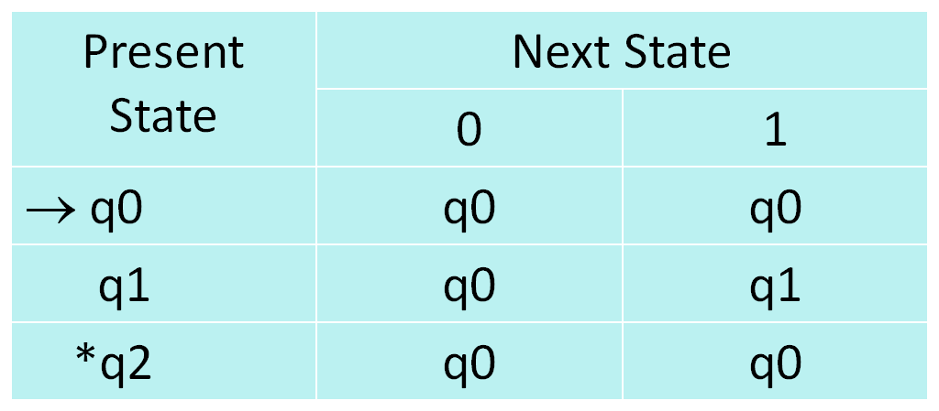
DFA
  Transition Table

Slide 51
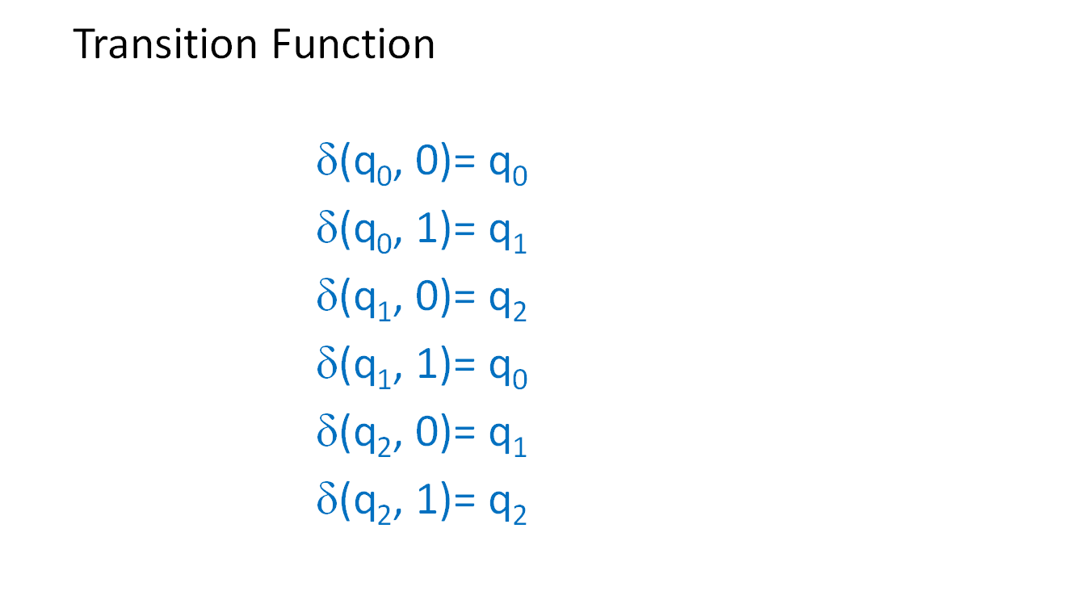
DFA

Slide 52
Example
0
1
0,1
q₀
1
q₁
0
q₂
alphabet Σ = {0, 1}
start state Q = {q₀, q₁, q₂}
initial state q₀
accepting states F = {q₀, q₁}
transition function δ:
inputs
0
1
q₀
q₀
q₁
states
q₁
q₂
q₁
q₂
q₂
q₂

Slide 53
Language of a DFA
The language of a DFA M=(Q, Σ, δ, q₀, F) is the set of all strings over Σ accepted by M i.e. L(M) and is denoted
L(M) = {w | w ∈ Σ∗ , δ(q_{0 ,} w) = q_{f} where q_{f} ∈ F}
f
M:
off
on
f
Language of M is {f, fff, fffff, …} = {f ^{n}: n is odd}

Slide 54
Example
0
0
1
The set of all string over {0,1} containing even no. of 1’s
q₀
q₁
1
0
1
The set of all string over {0,1} ending with 1’s
1
q₀
q₁
0
0
1
0,1
The set of all string over {0,1} does not contain 10 as substring
q₀
1
q₁
0
q₂

Slide 55
Exercise on DFA
Construct the DFA for the set of all string over {a,b}.
Construct the DFA for the set of all string over {a,b} contain exactly 3a’s .
Construct the DFA that accepts all string over{a,b} contains at most 3 a’s
Construct the DFA for the even number of a’s over {a,b}.
Construct the DFA for the set of all string contain three consecutive a’s over {a,b}.
Construct the DFA that accepts all string over{a,b} containing aba as substring.

Slide 56
Variation of Finite Automata
Deterministic Finite Automat
  δ: Q × Σ → Q
Non-Deterministic Finite Automata
  δ: Q x Σ → 2^{Q}
Non-Deterministic Finite Automata with Epsilon
    δ: Q x {Σ ∪ {ε}} → 2^{Q}
Finite Automata with output
  (Q, Σ, Δ, δ, λ, q0) where Q , Σ, δ, and q0 are similar to DFA and Δ is the set of output symbol and λ is out put function
    Moore Machine : the output is depend on present state λ : Q → Δ
    Mealy Machine : the output is depend on present state and current input applied on the state λ : Q x Σ → Δ

Slide 57
NFA
  In NFA, the machine can move from a present state to a combination of states for an input symbol that is why it is called non-deterministic. As the number of states are finite, it is called Non-deterministic Finite Automata.
q1
a
q0
a
q2

Slide 58
Formal definition of an NFA
An NFA is represented as a 5 tuples,
M={Q, ∑, δ, q₀, F}
Q= Non empty finite set of states
∑= Input alphabet
δ= Transition Function, δ: Q x ∑ → 2^{Q}
q₀= Initial State
F= Set of final states (F⊆ Q)

Slide 59
Difference between DFA and NFA
The transition from a state is to a single particular next state for each input symbol. Hence it is called deterministic. | The transition from a state can be to a combination of states for each input symbol. Hence it is called non-deterministic.
Ɛ-transition is not allowed in DFA. | NFA permits Ɛ-transition.
DFA takes more space. | NFA takes less space.
DFA is as powerful as NFA. | NFA is as powerful as DFA.
A string is accepted by a DFA, if it transits to a final state. | A string is accepted by a NDFA, if at least one of all possible transitions ends in a final state.
Every DFA is an NFA. | Every NFA is not a DFA.

Slide 60
Examples of DFA
Construct a DFA that accepts all strings over ∑={0,1} ending with 1.
Construct a DFA for L={w=(0,1)*| |w|=3n , n=0,1,2,...}
Construct a DFA for L= { all binary strings containing substring 001 }

Slide 61
Examples of DFA
Construct a DFA that accepts all strings over ∑={0,1} ending with 1.
1
0
1
q0
q1
0

Slide 62
Examples of DFA
Construct a DFA for L={w=(0,1)*| |w|=3n , n=0,1,2,...}
0, 1
0, 1
q0
q1
q2
0, 1

Slide 63
Examples of DFA
Construct a DFA for L= { all binary strings containing substring 001 }
0, 1
1
0
q0
0
q1
0
q2
1
q3
1

Slide 64
Examples of DFA
Construct a DFA for L= { all binary strings not containing substring 001 }
0, 1
1
0
q0
0
q1
0
q2
1
q3
1

Slide 65
Examples of NFA
Construct a NFA for L= { all strings beginning with aab }
a, b
q0
a
q1
a
q2
b
q3

Slide 66
Examples of NFA
Construct a NFA over ∑={a,b,c,d} that recognises abd, aacd or abdd.
q1
b
q2
d
q3
a
q0
a
q4
a
q5
c
q6
d
q7
a
q8
b
q9
d
q10
d
q11

Slide 67
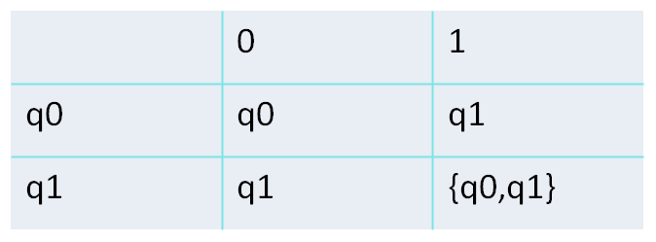
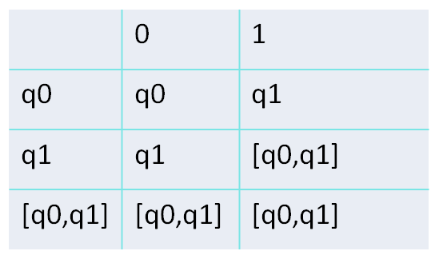
Conversion of NFA to DFA
Convert following NFA to DFA
0
1
0,1
q0
q1
1
0
0
0,1
[q0,q1]
q0
1
q1
1

Slide 68
Equivalence of NFA and DFA
Theorem: Every NFA has an equivalent DFA.
If a language L is accepted by an NFA then there exists an equivalent DFA that accepts L.

Slide 69
Equivalence of NFA and DFA (Proof)
Let L is accepted by NFA N = (Q_{N}, Σ_{N}, δ_{N}, q_{0N}, F_{N}).
Construct a DFA D= (Q_{D}, Σ_{D}, δ_{D}, q_{0D}, F_{D}) as follows.
Q_{D} is equal to the power set of Q_{N}, Q_{D} = 2^{QN}
Σ_{D} = Σ_{N} =∑
q_{0D} = {q_{0N}}
F_{D} is the set of states in Q_{D} that contain any element of F_{N.}
δ_{D} is the transition function for D.
δ_{D} (q,a)= ∪_{p∈q} δ_{N} (q,a)for q ∈ Q_{D} and a ∈ Σ.
p is a single state from Q_{N} .
δ_{D}(q,a) is the union of all δ_{N}(p,a).
Now we will prove that for every x, L(D) = L(N)

Slide 70
Equivalence of NFA and DFA (Proof)
Basis Step
Let x be the empty string ε.
δ_{D}(q_{0D,} x) = δ_{D}(q_{0D,} ε)
= q_{0D}
= {q_{0N} }
= δ_{N}(q_{0N,} ε)
= δ_{N}(q_{0N,} x)

Slide 71
Equivalence of NFA and DFA (Proof)
Inductive Step
Assume that for any y with |y| ≥ 0, δ_{D}(q_{0D,} y) = δ_{N}(q_{0N,} y).
If we let n = |y|, then we need to prove that for a string z with |z| = n + 1, δ_{D}(q_{0D,} z) = δ_{N}(q_{0N,} z) . We can represent the string z as a concatenation of string y (|y| = n) and symbol a from the alphabet Σ (a ∈ Σ). So, z = ya.
δ_{D}(q_{0D,} z) = δ_{D}(q_{0D,} ya)
= δ_{D}(δ_{N}(q_{0D,} y) ,a)
= δ_{D}(δ_{N}(q_{0N,} y) ,a) By assumption
= ∪ _{p∈ δN(q0N, y)} δ_{N}(q_{0N,} y) By definition of δ_{D}
= δ_{N}(q_{0N,} ya)
= δ_{N}(q_{0N,} z)
DFA D accepts a string x iff δ_{D}(q_{0D,} x) ∈ F_{D} . From the above it follows that D accepts x iff δ_{N}(q_{0N,} x) ∩ F_{N} = φ.
So a string is accepted by DFA D if, and only if, it is accepted by NFA N.

Slide 72
NFA with Ɛ- Transition
0
1
q0
ε
q1
We extend the class of an NFA by allowing ε transitions:
The automaton may be allowed to change its state without reading the input symbol.
Such transitions are depicted by labeling the appropriate arcs with ε.
‘ε’ does not belong to any alphabet (∑).

Slide 73
Why Ɛ- NFA ?/
ε -NFAs add a convenient feature.
Through ε –NFAs we can implement some complex languages easily.
They do not extend the power of an NFA.
Both NFAs and ε-NFAs have same power.

Slide 74
Formal definition of an Ɛ- NFA
An NFA is represented as a 5 tuples,
M={Q, ∑, δ, q₀, F}
Q= Non empty finite set of states
∑= Input alphabet
δ= Transition Function, δ: Q X (∑∪Ɛ) → 2^{Q}
q₀= Initial State
F= Set of final states (F⊆ Q)

Slide 75
Example of ε -NFA
Design an NFA for L={ a^{p}b^{q}c^{r}| p,q,r ≥0}.
a
b
c
q0
ε
q1
ε
q2

Slide 76
Example of ε -NFA
Design an NFA for L={ a^{n}| n is even or divisible by 3}.
a
q1
a
q2
ε
q0
a
ε
q3
q4
q5
a
a

Slide 77
ε –Closure of a state
The ε-closure of the state q, denoted as ε-Closure(q), is the set that contains q, together with all states that can be reached starting at q by following only ε-transitions.
a
b
c
q0
ε
q1
ε
q2
ε-Closure(q0) = {q0, q1, q2}
ε-Closure(q1) = {q1, q2}
ε-Closure(q2) = {q2}

Slide 78
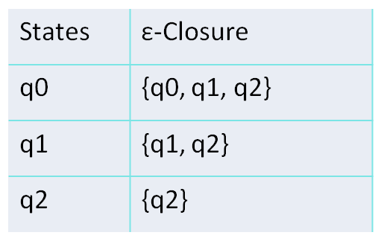
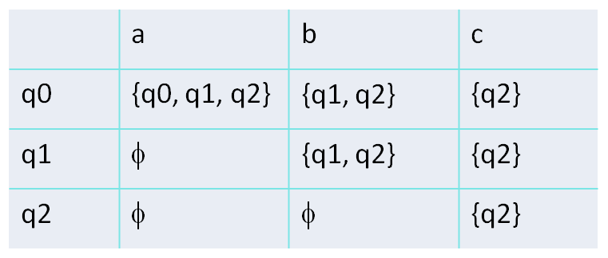
Conversion of ε –NFA to NFA
a
b
c
δ(q0, a)= ε-Closureδ(ε-Closure(q0), a)
= ε-Closureδ({ q0,q1,q2},a)
= ε-Closure(q0)
= {q0, q1, q2}
q0
ε
q1
ε
q2
a
b
c
q0
a, b
q1
b, c
q2
a, b, c

Slide 79
Minimization of DFA
Minimization of a DFA refers to the removal of those states of a DFA, whose presence or absence in a DFA does not affect the language accepted by the automata.
The states that can be eliminated from automata are:
Unreachable or inaccessible states.
Dead states.
Non-distinguishable or indistinguishable state or equivalent states.

Slide 80
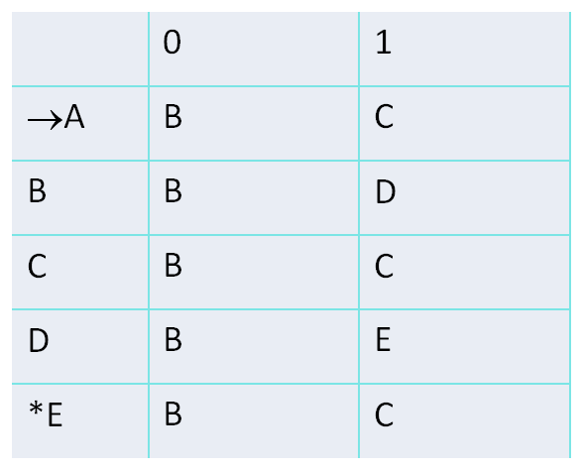
Minimization of DFA
Minimize the following DFA:
0
0
Transition Table
B
1
D
0
A
0
1
0
1
C
E
1
1

Slide 81
Minimization of DFA
Eqivalent State
Two states qi and qj are equivalent or indistinguishable (for the future), if, when started in these states, every string causes the machine to either end up in an accepting state for both or end up in a non-accepting state for both.
qi
qm
a
qj
qn
a
If qm and qn are distinguishable, then so are qi and qj

Slide 82
Minimization of DFA
Suppose there is a DFA D < Q, Σ, q0, δ, F > which recognizes a language L. Then the minimized DFA D < Q’, Σ, q0, δ’, F’ > can be constructed for language L as:
Step 1: We will divide Q (set of states) into two sets. One set will contain all final states and other set will contain non-final states. This partition is called Π₀.
Step 2: Initialize k = 1
Step 3: Find Πk by partitioning the different sets of Πk-1. In each set of Πk-1, we will take all possible pair of states. If two states of a set are distinguishable, we will split the sets into different sets in Πk.
Step 4: Stop when Πk = Πk-1 (No change in partition)
Step 5: All states of one set are merged into one. No. of states in minimized DFA will be equal to no. of sets in Πk.

Slide 83
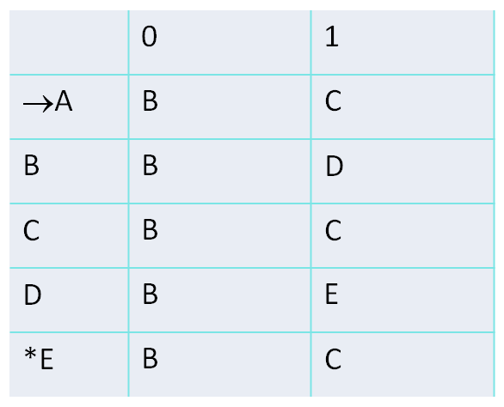
Minimization of DFA
Find Equivalence classes
Π₀= {A,B,C,D} {E}
Π₁= {A,B,C} {D} {E}
Π₂= {A,C} {B} {D} {E}
Π₃= {A,C} {B} {D} {E}
Π₂= Π₃ ,so stop here.
Transition Table

Slide 84
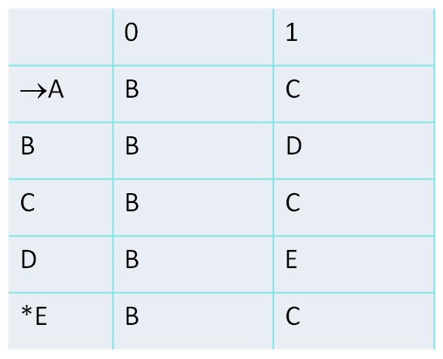
Minimization of DFA
{A,C} {B} {D} {E}
Transition Table
0
0
B
1
D
0
AC
0
1
0
1
E

Slide 85
Minimization of DFA
Using Table Filling Method (Myhill-Nerode Theorem)
Step 1: Draw a table for all pairs of states (P,Q) not necessarily connected directly [All are unmarked initially].
Step 2: Consider every state pair (P,Q) in the DFA where P ∈ F and Q ∉ F or vice versa and mark (X) them. [Here F is the set of final states].

Slide 86
Minimization of DFA
Using Table Filling Method (Myhill-Nerode Theorem)
Contd…
Step 3: Repeat this step until we cannot mark anymore states − If there is an unmarked pair (P, Q ), such that {δ(P , a), δ (Q , a)} is marked then mark (P,Q), where a ∈ ∑.
Step 4: Combine all the unmarked pair (P , Q ) and make them a single state in the reduced DFA.

Slide 87
Minimization of DFA
Minimize the following DFA.
0, 1
B
1
D
1
F
1
0
0
1
0
A
C
E
1
0
0

Slide 88
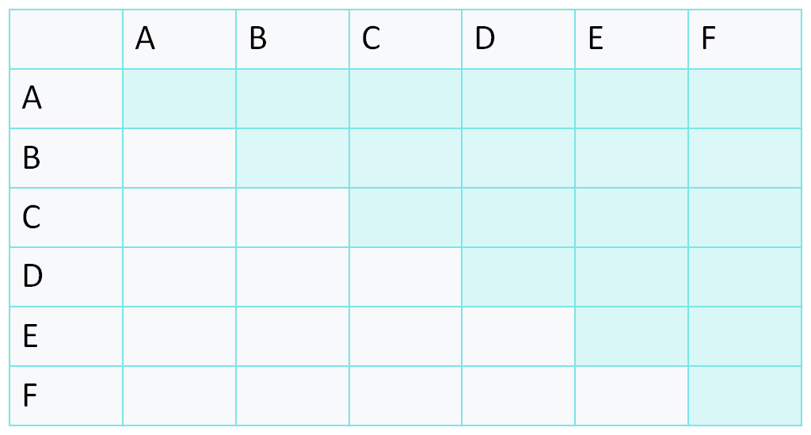
Minimization of DFA
Step 1: Draw a Table for all pair of states (P,Q).

Slide 89
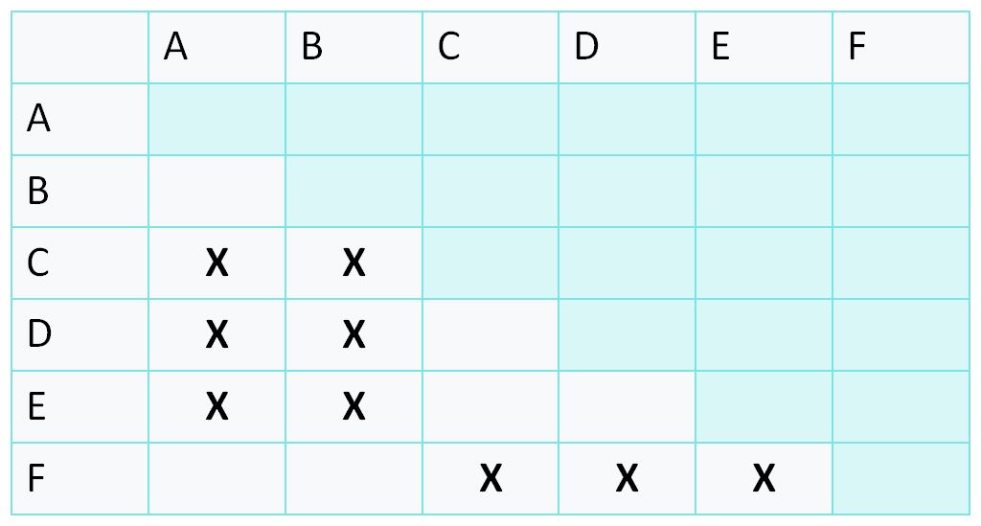
Minimization of DFA
Step 2: Mark every state pair (P,Q) in the DFA where P ∈ F and Q ∉ F .

Slide 90
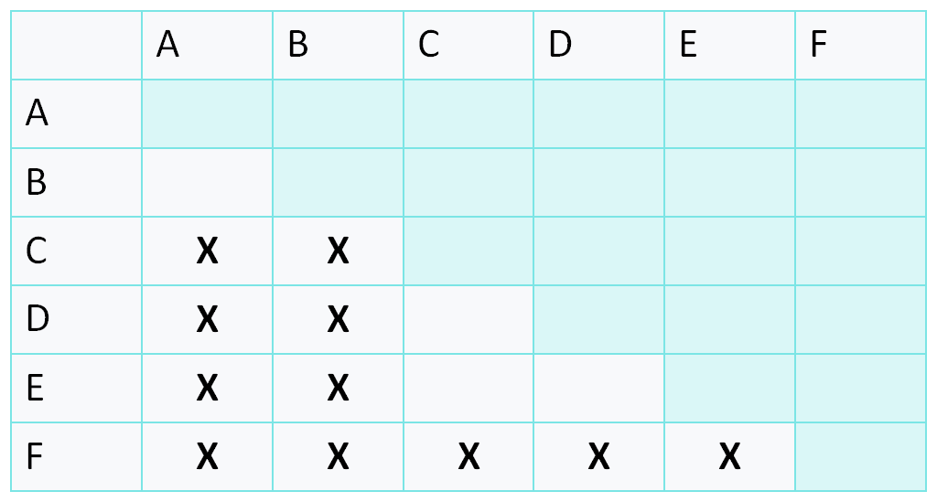
Minimization of DFA
Step 3: − If there is an unmarked pair (P, Q ), such that {δ(P , a), δ (Q , a)} is marked then mark (P,Q).

Slide 91
Minimization of DFA
After step 3, we have got state combinations {a, b} {c, d} {c, e} {d, e} that are unmarked.
We can recombine {c, d} {c, e} {d, e} into {c, d, e}.
Hence we got two combined states as − {a, b} and {c, d, e}.
So the final minimized DFA will contain three states {f}, {a, b} and {c, d, e}.
0
0
0, 1
[AB]
1
[CDE]
1
F

Slide 92
Daily Quiz
1. One language can be expressed by more than one FA”. This statement is ______
True
False
Some times true & sometimes false
None of these
2. Can a DFA simulate NFA?
NO
YES
SOMETIMES
Depends on NFA

Slide 93
Daily Quiz
3. Which of the following statements is wrong ?
A. The language accepted by finite automata are the languages denoted by regular expressions
B. For every DFA there is a regular expression denoting its language
C. For a regular expression r, there does not exist NFA with L(r) any transit that accept
D. None of these
4. An automation is a __________ device and a grammar is a __________ device.
A. generative, cognitive
B. generative, acceptor
C. acceptor, cognitive
D. cognitive, generative

Slide 94
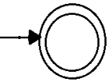
Daily Quiz
5. Finite state machines _________ recognize palindromes
A. can
B. can't
C. may
D. may not
6. FSM shown in the figure
A. all strings
B. no string
C. ε- alone
D. none of these

Slide 95
Daily Quiz
7. A FSM can be used to add how many given integers?
1
2
3
Any number of integers
8. The basic limitation of a FSM is that
It cannot remember arbitrary large amount of information
It sometimes recognizes grammar that are not regular
It sometimes fails to recognize grammars that are regular
All of the above

Slide 96
Daily Quiz
9. Finite automata are used for pattern matching in text editors for
Compiler lexical analysis
Programming in localized application
Both A and B
None of the above
10. The language accepted by finite automata is
Context free
Regular
Non regular
None of these

Slide 97
Finite Automata with Output
Objective of the Topic
The objective of the topic is to make the student able to:
Understand the requirement of FA with output.
Implement Mealy and Moore machine.
Convert Mealy machine to Moore machine and vice-versa.

Slide 98
Finite Automata
Topic mapping with Course Outcome
Topic | CO1 | CO2 | CO3 | CO4 | CO5
Finite Automata with Output | 3 | - | - | - | -

Slide 99
Finite Automata with Output
The Finite Automata Discussed so far have limited capability i.e. accepting or rejecting a string.
Finite Automata with output do not have final state.
Finite Automata with output are of two types:
  Mealy Machine
  Moore Machine

Slide 100
Finite Automata with Output
  Mealy Machine
    The out put is associated with transition. The output depends on present state and present input.
  Moore Machine
    The output is associated with present state. The output depends on present state only.
λ: Q X ∑ → Δ
λ: Q → Δ

Slide 101
Formal Definition of Mealy Machine
Mealy machine is described by 6-tuples - (Q, Σ, Δ, δ, λ, q0)
where
Q = Finite non-empty set of states;
Σ = Set of input alphabets.
Δ = Set of output alphabets.
δ = Transitional function mapping Q X Σ → Q
λ = Output function mapping Q X Σ → Δ
q0 = Initial state
Vineet Kumar KCS-402 (TOAFL) Unit I

Slide 102
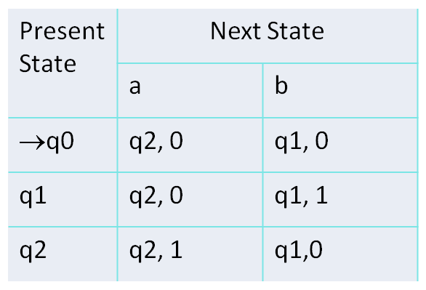
Example of Mealy Machine
Design a Mealy machine that accepts all strings over ∑={a, b} ending in aa or bb.
a/1
q2
a/0
a/0
b/0
q0
b/0
q1
b/1

Slide 103
Formal Definition of Moore Machine
Moore machine is described by 6-tuples - (Q, Σ, Δ, δ, λ, q0)
where
Q = Finite non-empty set of states;
Σ = Set of input alphabets.
Δ = Set of output alphabets.
δ = Transitional function mapping Q X Σ → Q
λ = Output function mapping Q → Δ
q0 = Initial state
Vineet Kumar KCS-402 (TOAFL) Unit I

Slide 104
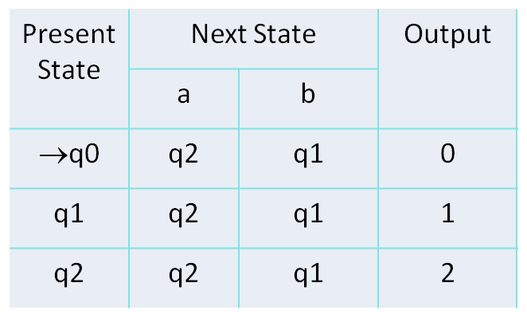
Example of Moore Machine
Create a Moore machine that counts number of a mod3. ∑={a, b}.
b
b
b
q0/0
a
q1/1
a
q2/2
a

Slide 105
Conversion from Mealy machine to Moore machine
Step 1: For each state q determine the number of outputs that are associated with q in Next state column of transition table of the Mealy machine.
Step 2: If the outputs corresponding to state q in the next state columns are same, then retain state q as it is.
Else, break q into different states with the number of new states being equal to the number of different outputs of q.
Step 3: Rearrange the states and outputs in the format of Moore machine.

Slide 106
Conversion from Mealy machine to Moore machine
Step 4: If the output in the constructed state table corresponding to the initial state is 1, then this specifies the acceptance of the null string Ɛ by Mealy machine. Hence, to make both the Mealy and Moore machines equivalent, we either need to ignore the corresponding to null string or we need to insert a new initial state at beginning whose output is 0; the other row elements in this case would remain the same.

Slide 107
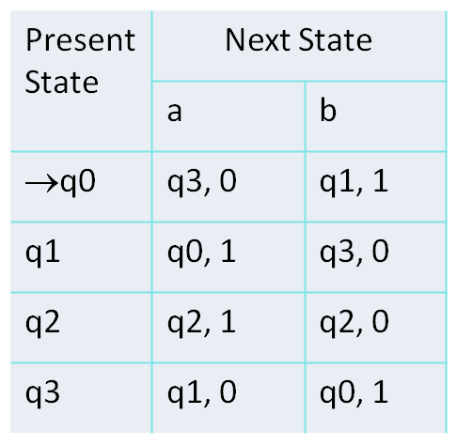
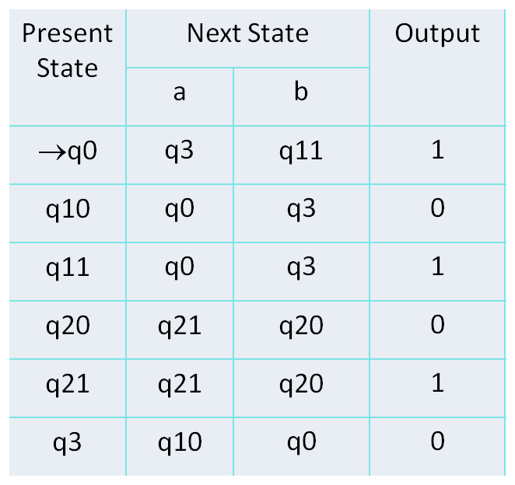
Conversion from Mealy machine to Moore machine
Convert given Mealy machine to Moore machine.
Mealy Machine
Moore Machine
Split q1 into q10 and q11
and
Split q2 into q20 and q21

Slide 108
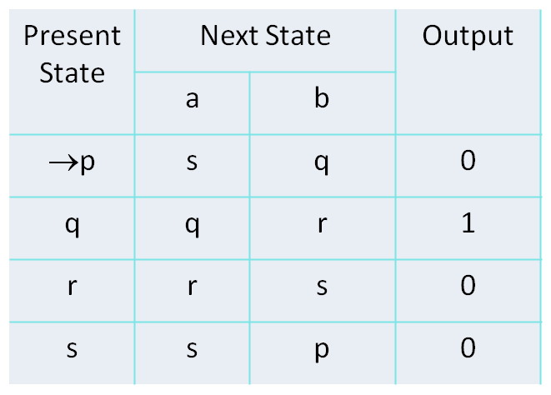
Conversion from Moore machine to Mealy machine
For understanding the conversion of Moore machine to Mealy machine, let us take an example:
Suppose the Moore machine transition table is:

Slide 109
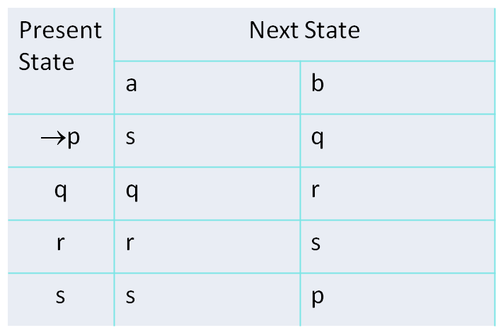
Conversion from Moore machine to Mealy machine
First of all take the Mealy machine transition table format, and copy all the Moore machine transition table states into Mealy machine transition table.

Slide 110
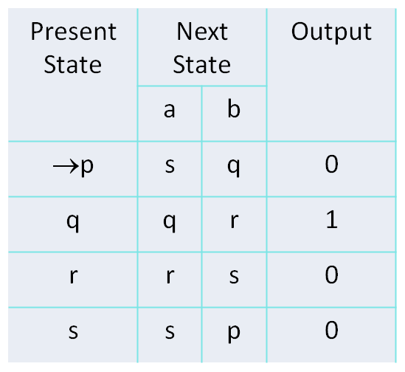
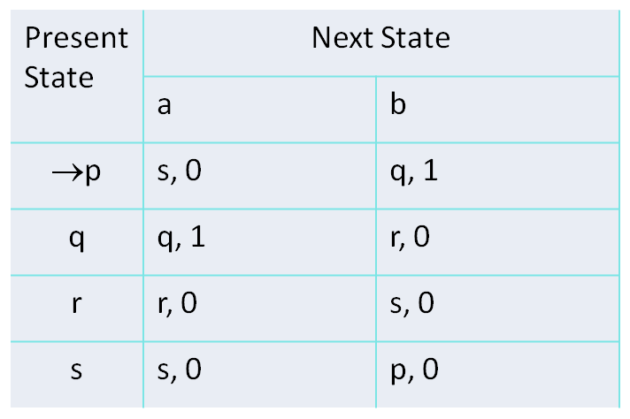
Conversion from Moore m/c to Mealy m/c
Now in the Moore machine, the output of state p is 0. So make the output of p in the Mealy machine next state column of the above table is 0. Same process is repeated for q, r and s.
Moore Machine
Mealy Machine

Slide 111
Difference Between Mealy And Moore Machine
BASIS OF COMPARISON | MEALY MACHINE | MOORE MACHINE
Description | Mealy machine changes its output based on its current input and present state. | Output of Moore machine only depends on its current state and not on the current input.
Output | Output is placed on transition. | Output is placed on transition.
Output Function | λ: Q X ∑ → Δ | λ: Q → Δ
Counter | A counter is not a Mealy machine. | A counter is a Moore machine.
Design | Not necessarily easy to design. | Easy to design.
Length of Out put String | It produce n length output string corresponding to n length input String | It produce n+1 length output string corresponding to n length input String

Slide 112
Video Links
NPTEL Video Links
https://youtu.be/al4AK6ruRek
https://youtu.be/539Bk9fFOyo
https://youtu.be/r20I_inUNv8

Slide 113
Daily Quiz
Given: ∑= {a, b}L= {xϵ∑*|x is a string combination}∑4 represents which among the following? *
{aa, ab, ba, bb}
{aaaa, abab, ε, abaa, aabb}
{aaa, aab, aba, bbb}
All of the mentioned
2. Converting each of the final states of F to non-final states and old non-final states of F to final states, FA thus obtained will reject every string belonging to L and will accept every string, defined over Σ, not belonging to L. is called
Transition Graph of L
Regular expression of L
Complement of L
Finite Automata of L

Slide 114
Daily Quiz
3. Myhill Nerode theorem is consisting of the followings,
L partitions Σ into distinct classes.
If L is regular then, L generates finite number of classes.
If L generates finite number of classes, then L is regular.
All of above
4. The part of an FA, where the input string is placed before it is run, is called ______
State
Transition
Input Tape
D. Output Tape

Slide 115
Daily Quiz
5. Which of the following is an application of Finite Automaton?
Compiler Design
Grammar Parsers
Text Search
All of the mentioned
6. Which of the following is a not a part of 5-tuple finite automata?
Input alphabet
Transition function
Initial State
Output Alphabet

Slide 116
Daily Quiz
7. John is asked to make an automaton which accepts a given string for all the occurrence of ‘1001’ in it. How many number of transitions would John use such that, the string processing application works?
9
11
12
15
8. The total number of states to build the given language using DFA:
L= {w | w has exactly 2 a’s and at least 2 b’s}
10
11
12
13

Slide 117
Daily Quiz
9. A binary string is divisible by 4 if and only if it ends with:
a) 100
b) 1000
c) 1100
d) 0011
10. Let N (Q, ∑, δ, q0, A) be the NFA recognizing a language L. Then for a DFA (Q’, ∑, δ’, q0’, A’), which among the following is true?
a) Q’ = P(Q)
b) Δ’ = δ’ (R, a) = {q ϵ Q | q ϵ δ (r, a), for some r ϵ R}
c) Q’={q0}
d) All of the mentioned

Slide 118
Weekly Assignment
1. Design a deterministic finite automaton(DFA) for the following language over the set of input alphabet {0,1} [CO1]
All strings of 0’s and 1’s such that no of 0’s are even and 1’s are odd.
All strings of 0’s and 1’s with at least two consecutive 0’s.
All strings of 0’s and 1’s beginning with 1 and not having two consecutive zeroes.
All strings of 0’s and 1’ s not containing 101 as substring.
All strings of 0’s and 1’s whose last two symbols are same.

Slide 119
Weekly Assignment
2. Design a Non-deterministic finite automaton(NFA) for the following language over the set of input alphabet {0,1} [CO1]
All strings of 0’s and 1’s such that 3rd symbol from right end is 1.
All strings of 0’s and 1’s such that either the 2nd or 3rd position from the right end has a 1.
All strings of 0’s and 1’s satisfying 1^{m}01^{n} : m, n>=1.
All strings of 0’s, 1’s and 2’s with any no of 0’s followed by any no of 1’s and any no of 1’s followed by any no of 2’s.
All strings of 0’s and 1’s ending in1 and not containing substring 00.

Slide 120
Weekly Assignment
3. Prove that NFA is equivalent to DFA. [CO1]
4. Construct NFA accepting the set of all strings over {a, b} ending in aba. Use it to construct a DFA accepting the same set of strings. [CO1]
5. Design a NFA with epsilonthat accepts {a, b}*baaa.[CO1]
6. Design a NFA that accepts (a+b)*(ab+bba) (a+b)* i.e. strings containing either ab or bba as substring . convert it into DFA. [CO1]
7. Differentiate between DFA and NDFA with suitable example? [CO1]
8. Describe various Application and Limitations of Finite Automata. [CO1]

Slide 121
MCQ s
1. A binary string is divisible by 4 if and only if it ends with:
100
1000
1100
0011
2. Recognizing capabilities of NFSM and DFSM
May be different
May be same
Must be different
None of the above

Slide 122
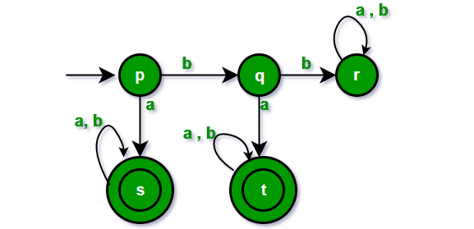
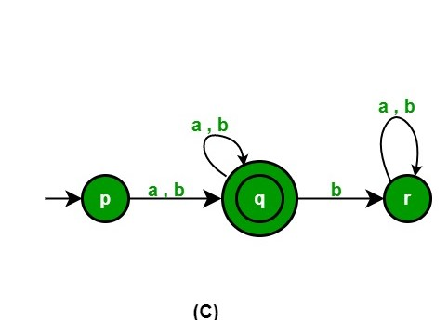
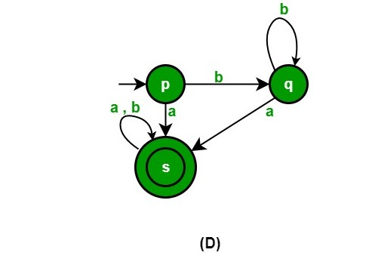
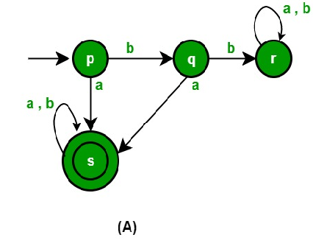
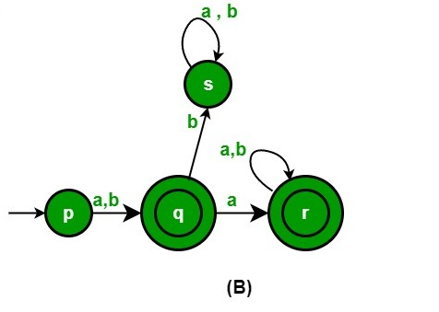
MCQ s
3. Which minimum state FA is equivalent to following FA
ANS : (A)

Slide 123
MCQ s
4. The minimum number of states required to recognize an octal number divisible by 3 are/is
1
3
5
7
5. Which of the following is/ are regular
a string of a' s in perfect square
a string of palindrom over {a,b}
a string of odd no of a's over {a,b}
a string of equal no of a's and b's over {a,b}

Slide 124
MCQ s
6. If two finite state machines are equivalent, they should have the same number of
A. states
B. edges
C. states and edges
D. none of these
7. The word 'formal' in formal languages means
the symbols used have well-defined meaning
they are unnecessary, in reality
only form of the string of symbols is significant
Both (a) and (b)

Slide 125
MCQ s
8. The main difference between a DFSA and an NDFSA is
A. in DFSA, ε transition may be present
B. in NDFSA, ε transitions may be present
C. in DFSA, from any given state, there can't be any alphabet leading to two diferent states
D. in NDFSA, from any given state, there can't be any alphabet leading to two different states
9. Palindromes can't be recognized by any FSM because
A. FSM can't remember arbitrarily large of information
B. FSM can't deterministically fix the mid-point
C. even if mid-point is known, FSM be can't be found whether, second half of the string matches the first half
D. all of these

Slide 126
Old Question Papers
https://drive.google.com/drive/folders/19Eia3VHCl3627foiH6V_j-p4X9ZkyyC7?usp=sharing

Slide 127
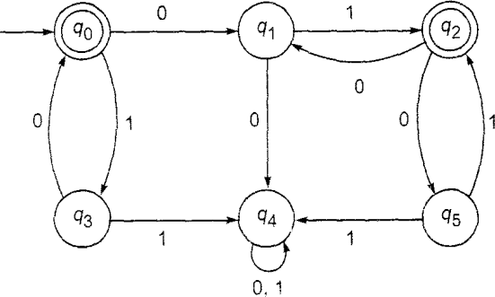
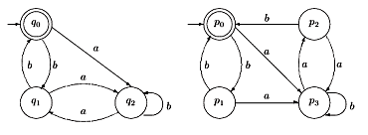
Expected Questions for University Exam
Design a NFA that accepts all the strings for input alphabet {a,b} containing the substring abba.
Convert NFA into equivalent DFA by taking any suitable example.
Design the DFA that accepts an even number of a’s and even number of b’s.
Construct the minimum state automata equivalent to DFA described below:
Check with the comparison method for testing equivalence of two FA given below:

Slide 128
Summary
Finite automata is a machine that acccepts regular languages.
FA has its application in many fields like compiler design, digital circuits, etc.
NFA and DFA has same expressive power.
NFA is easy to construct than DFA.
Every NFA is equivalent to DFA.
Myhill-Nerode theorem is used to optimize the FA.

Slide 129
References
Hopcroft, J. E., Motwani, R., & Ullman, J. D. (2001). Introduction to automata theory, languages, and computation. Acm Sigact News, 32(1), 60-65.
Linz, P. (2006). An introduction to formal languages and automata. Jones & Bartlett Learning.
Mishra, K. L. P., & Chandrasekaran, N. (2006). Theory of Computer Science: Automata, Languages and Computation. PHI Learning Pvt. Ltd..

Slide 130


